Slide 1
IMDB score prediction
Phase_3 :Development 1

Slide 2
Import Necessary Libraries:
The first step in our IMDb score prediction project is to load the dataset into our Python environment. We're using a CSV file containing information about movies, including various features and their corresponding IMDb scores.
PROGRAM:
import pandas as pd

Slide 3
Load the Dataset:
Use The pandas Library To Load our Dataset from the kaggle website.
I was Working With A CSV File, I Can Use Pandas With Pd. Read _Csv( ).
PROGRAM
# Load the dataset
data = pd.read_csv('NetflixOriginals.csv')

Slide 4
DATA EXPLORATION:
Perform Initial Data Exploration To Understand
structure
features
content
Use functions were
head( )
info( )
describe( )
in Pandas for tabular data.

Slide 5
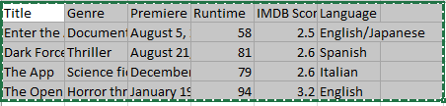
Df.head( )
It is used to display the first few rows of a Pandas DataFrame.

Slide 6
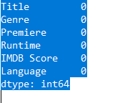
data.isin(['?']).any()
This Code Is Often Used To Identify Missing Or Placeholder Values In A Dataframe.
The '?' Character Is A Common Choice For Representing Missing Or Unknown Data.
If Any Cell In The 'Data' Dataframe Contains A '?', Data.Isin(['?']).Any() Will Return True, Indicating The Presence Of Missing Or Unknown Values In The Dataframe. If All Cells Are Populate With Valid Data, It Will Return False.

Slide 7
Preprocessing
The purpose of this program is to clean and prepare the 'data' DataFrame by ensuring that all values are in a numeric format, resetting the index to default integers, and removing any extraneous 'index' column.
when working with data that might have mixed data types, non-standard indices, or unnecessary columns.

